Slide 1
Game Development 2A
Generics

Slide 2
A review of collections
Add
01
Remove
02
Count
03
Contains
04
Clear
05
IndexOf
06

Slide 3

collections
Finishing the collection
IndexOf
Contains

Slide 4
generics
Generics are C#’s equivalent to template classes in C++ or Java
Generic functions
Generic classes
Allows you to define data structures as type agnostic and write code that will make generic comparisons necessary for class operations
You put placeholders as T where you would need to indicate an object type
Reduces code bloat
You don’t have to write differently typed data structures for different scenarios

Slide 5
creating A GENERIC COLLECTION
Generic code uses the placeholder Type T to refer to a non specific variable type
1
You need to specify that a class/method is templated in the class or method header
2
public class Collection<T> specifies this is a generic collection
3
void Swap<T> is a method where something is generic (such as parameters). This does not need to be used if the class is marked as generic.
4

Slide 6
Passing “t” as a parameter
What are simple data types passed by in C#?
Complex data types?
What could the problem be if you were declaring a parameter as generic when it comes to data type passing?
How do we pass by reference explicitly?

Slide 7
Passing by reference
Using the ref keyword
01
When passing T parameters in scenarios where we’re making changes to data, we always need to specify ref in order to treat our generic data parameter as an object
02
This has its disadvantages
03

Slide 8
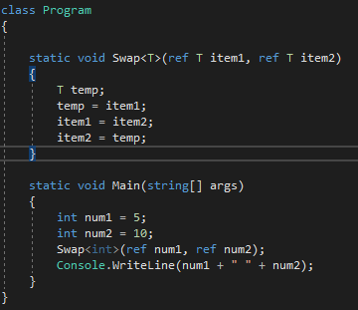
Generic method: example

Slide 9
exercise
Change your Collection from earlier, that inherited from CollectionBase, into a Generic Collection
1
Take out the reference to CollectionBase
2
Make everything generic types
3
Create a ToString() that iterates through the internal structure and builds a string for output with a blank line in between
4

Slide 10
Creating the most generic building block
When we start to work with generic items, we’ll need some sort of base unit
What do we consider these base units to be in C#?
Item with a “single” value

Slide 11
The node class
The Node class is our wrapper for a generic object
1
Needs a reference to an element
2
Needs a constructor that gives that elements its value
3
Need properties to change the value of the node
5
Needs as constructor for an empty node we can set later
4

Slide 12
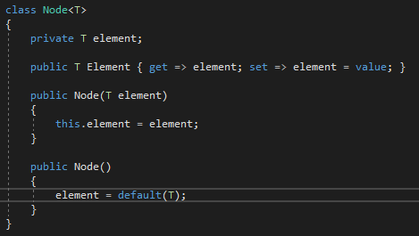
The node class

Slide 13

Connecting the node to other nodes
What internal logic would we need to connect this primitive Node to other Nodes?

